Slide 1
Use of STANDARD HTS logbook IN RWANDA
Presenter: UWIMANA JMV

Slide 2
OutLine
Rwanda and HIV/AIDS situation
National Lab network and testing services delivery
National HIV Rapid Diagnostic Testing Algorithm
Use of HTS standard Logbook in Rwanda
Lessons learnt

Slide 3
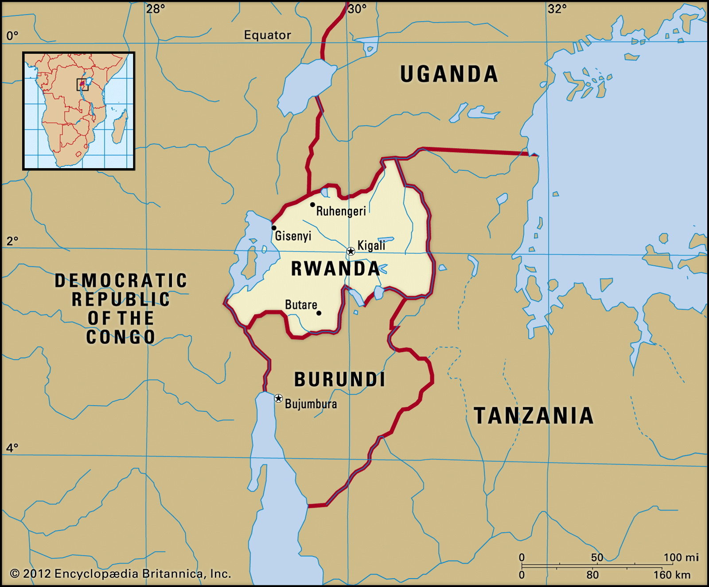
Rwanda and HIV/AIDS situation
Located in eastern central region of Africa; the land of a thousand hills.
Rwanda population is over 13 millions (National Census Report 2022).
Female population is higher than male, at 51.5%.
Younger population with youth (16-30 yo) constitute 27.1% and 45% children (0-17 yo).
HIV/AIDS burden in Rwanda
HIV prevalence among adults is 3.0% and low incidence at 0.08% (RPHIA 2018/19).
Generalized HIV epidemic with large burden in key populations (UNAIDS).
Surpassed (Nationally) the 90-90-90 goals of UNAIDS towards reaching HIV epidemic control by 2030.

Slide 4
National Lab network and testing services delivery
Advanced and specialized routine testing
Oversight of the lab network
QMS and EQA/PT implementation
NRL
Level 4 Referral Hospital N=8
Complimentary services to routine testing such as microbiology examinations and referred testing lab network
Supports implementation and monitoring for EQA/PT and other quality improvement initiatives at sites in their catchment area such as Q-corps in RTCQI rollout.
Level 3 Provincial Hospital
N=4
Level 2
District Hospital
N=41
Level 1 Public Health Centers N=561
Health Post N=1094
Private Clinics N=318
Routine clinical testing services and implement QA/QC of testing
(Biochemistry, Hematology, Microscopy, Rapid device/ Strip tests)
Most of the primary healthcare services delivered here including HIV/TB and others

Slide 5
National HIV Rapid Diagnostic Testing Algorithm
Serial algorithm currently with 2 rapid HIV tests
Handling of inconclusive results
Repeat testing after 2 weeks
Refer for PCR test
Test outcomes and reported results are recorded into HTS testing register
Early detect Determine
Non-reactive
Reactive
Report HIV-
STAT-PAK
Reactive
Non-reactive
Report HIV+
Report Inconclusive
Invalid
Invalid
Repeat test if invalid

Slide 6
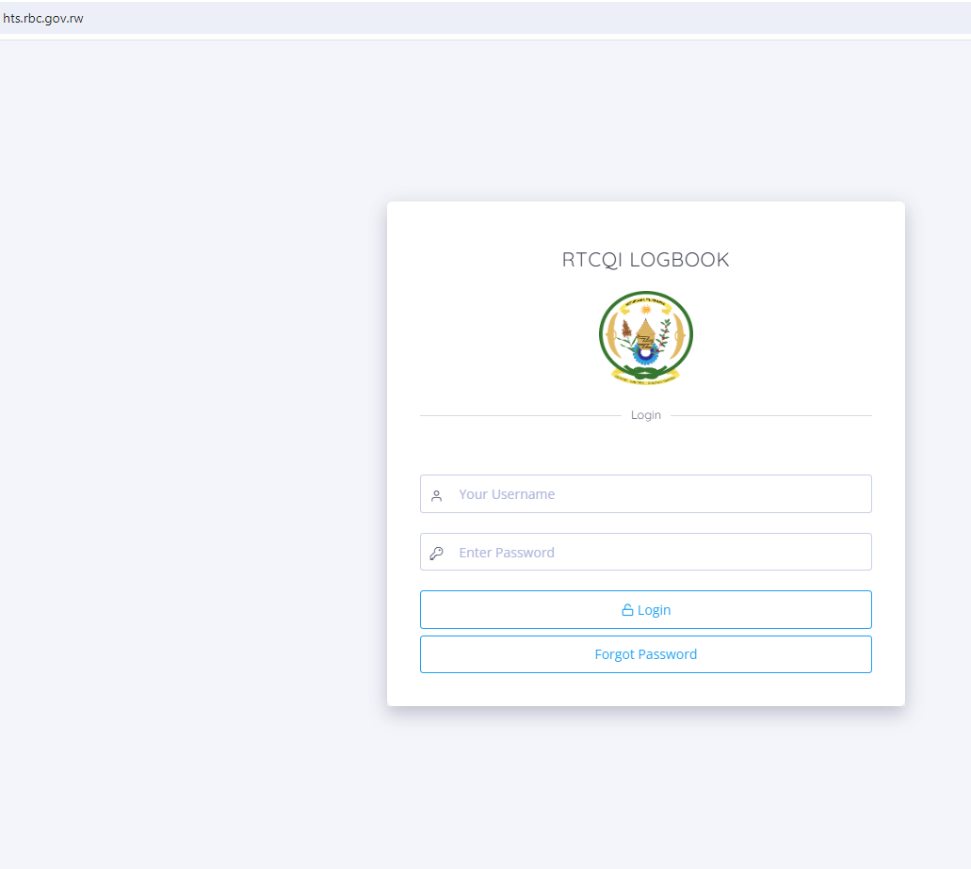
Rwanda ehts situation
Used at 100% PEPFAR sites since 2018
Accessible online
Helps monitor the quality of testing across all sites
Guides commodity quantification

Slide 7
utility
Simplify data aggregation for report generation and review by site supervisor/ manager.
Enhances monitoring the quality of testing to inform training needs at testing sites
Monthly monitoring of the quality of HIV rapid testing performance at testing points
Requires data management procedures and processes for effective reporting
Build capacity of the Q-corps to provide adequate quality monitoring skills and offer supportive supervision to HTS sites in their catchment area.

Slide 8
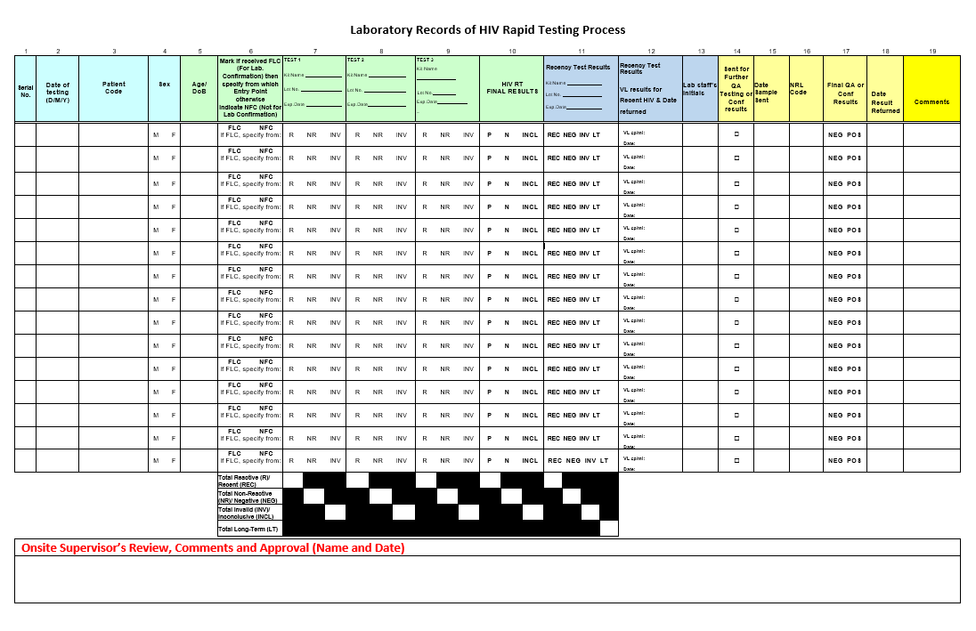
Key QA indicators from logbook captured into eHTS
Client particulars: testing code/ID, Age and Sex
Tester particulars
Dates of testing and results reported
Test kit lot information and kit expiration date
Outcome for each test in the algorithm
Final HIV test results
Page totals

Slide 10
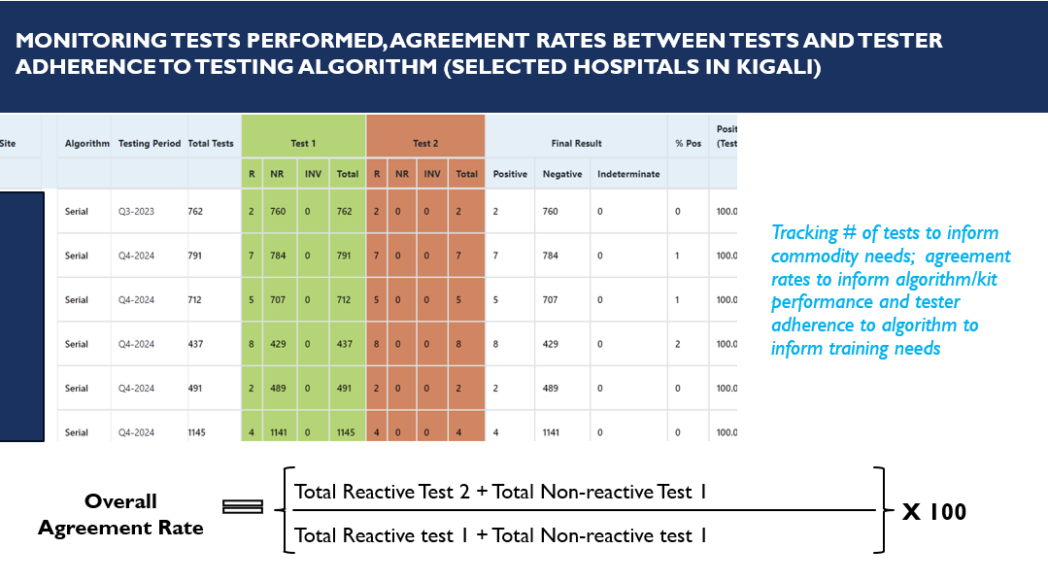

Slide 11
Lessons learnt and challenges/opportunities to improve
Challenges and opportunities
Inadequate data quality including missing data from some sites in eHTS.
Turnover of trained staffs at site level.
Inadequate support and capacity for Q-corps to perform their responsibility as required.
Requires periodic system upgrade to minimize user error
Irregularity in site reporting affects system improvement
Additional workload for staff at HF with multiple testing points
Lessons learnt
eHTS facilitates reporting of HTS aggregated data.
Helps NRL to:
Track # of tests performed to inform commodity needs
Agreement rates to monitor algorithm/kit performance
Tester adherence to algorithm to inform training needs
Improves commodity forecasting and inventory management.

Slide 12
ACKNOWLEDGEMENTS
US Centers for Disease Control and Prevention (CDC)
Africa Field Epidemiology Network (AFENET)
Rwanda Biomedical Center/ National Reference Laboratory (NRL)
Rwanda Ministry of Health, ICAP and Ngarama Hospital
PEPFAR

Slide 13
THANK YOU

